Slide 1

welcome

Slide 2
Intel Corporation Name : - Atanu Guchhait University name : Brainware university Programe name : - b.tech cse aiml group : - d student code : - bwu/bta/22/223

Slide 3
Problem statement AI Powered Personalized Tutor system

Slide 4
contents
Introduction
Problem Statement
Proposed Solution
Technology Used
System Architecture Flow
Diagram Of Architecture
Model Evaluation And Result
Challenges And Limitations
Conclusion
Reference
Page : 1

Slide 5
Introduction
The AI-Powered Personal Tutor is an intelligent, scalable system designed to enhance student engagement by providing personalized learning experiences. Traditional educational methods often fail to address the diverse learning paces and styles of students. This project aims to leverage Artificial Intelligence to create a tutor that adapts to each student's unique needs, offering real-time feedback, customized learning paths, and interactive support. The goal is to provide students with a more engaging, effective, and personalized learning experience, making education more accessible and tailored.
Page : 2

Slide 6
Problem Statement
Lack of Personalization: Traditional education systems do not cater to the diverse learning paces and styles of individual students.
One-Size-Fits-All Approach: Most educational methods provide the same content and difficulty level for all students, ignoring their unique needs.
Student Disengagement: Without personalized learning experiences, students may feel disengaged or overwhelmed, which negatively impacts their motivation.
Inefficient Resource Utilization: Educators spend significant time on repetitive tasks, reducing their capacity to provide individualized support.
Page : 3

Slide 7
Proposed solution
Our AI-powered personal tutor aims to revolutionize education by leveraging advanced machine learning and natural language processing techniques. It predicts student assessment scores based on past performance, enabling educators to identify learning gaps early. The system also makes smart promotion decisions, determining whether a student is ready to advance based on their mastery of concepts. To enhance learning, it offers personalized content recommendations, tailoring study materials to each student's level and progress. Additionally, a PDF querying system, powered by a RAG-based pipeline, allows students to efficiently extract relevant information from uploaded documents. Lastly, the solution performs retention analysis, identifying which content should be kept or skipped based on student-level performance data and material effectiveness. This holistic approach promotes adaptive learning, making education more personalized and effective.
Page : 4

Slide 8

Technology used
Data Manipulation and Analysis: Numpy, Pandas for Pre-processing.
Data Visualization : Matplotlib, Seaborn For visualization.
Machine Learning (ML): Scikit-learn, Pickle, Column Transformer, Scikit-learn Pipeline.
Natural Language Processing (NLP): For intelligent interaction with students, enabling them to ask questions and receive explanations in natural language.
Rag-Pipeline : For PDF Query.
Streamlit/HTML/CSS: For building interactive and user-friendly web interfaces for both students and educators.
Page : 5

Slide 9
SYStem architecture FLOW
Flow of the Application:
Login/Registration Page: Users can register or log in.
Once logged in, users can access the to navigate between the sections:
Student Promotion Prediction: Forecasting student readiness for the next level.
Assessment Score Prediction: Estimating future performance.
Level-Based Recommendations: Suggesting tailored materials for each student level.
Content Retention/Skipping: Identifying essential content and what can be skipped.
PDF Querying: Extracting insights from uploaded PDFs.
Page : 6

Slide 10
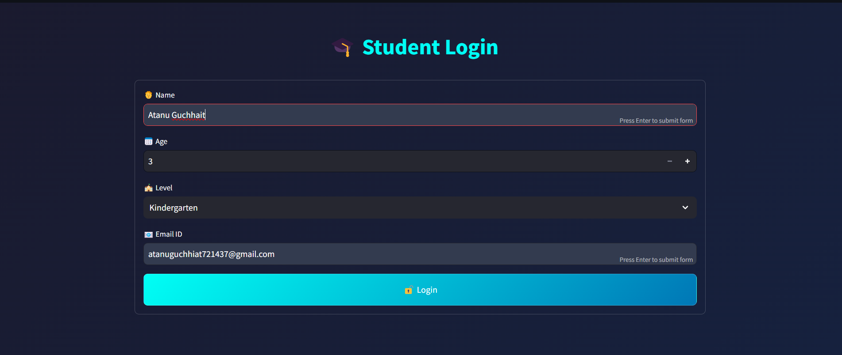
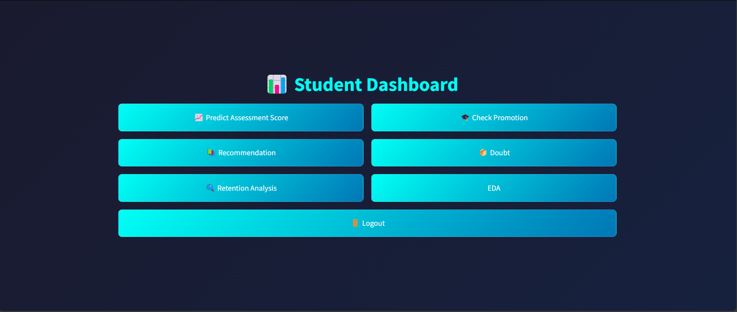
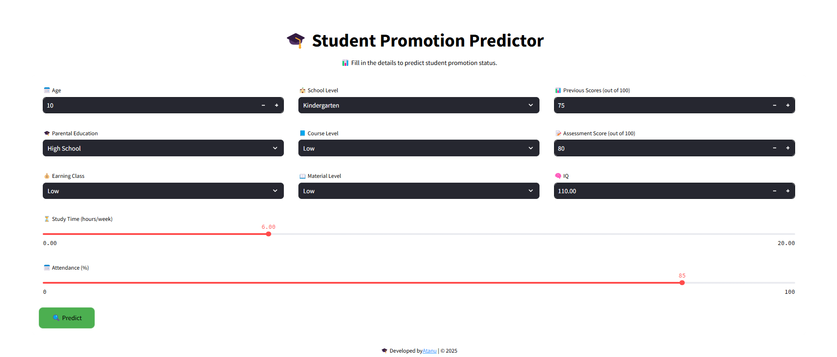
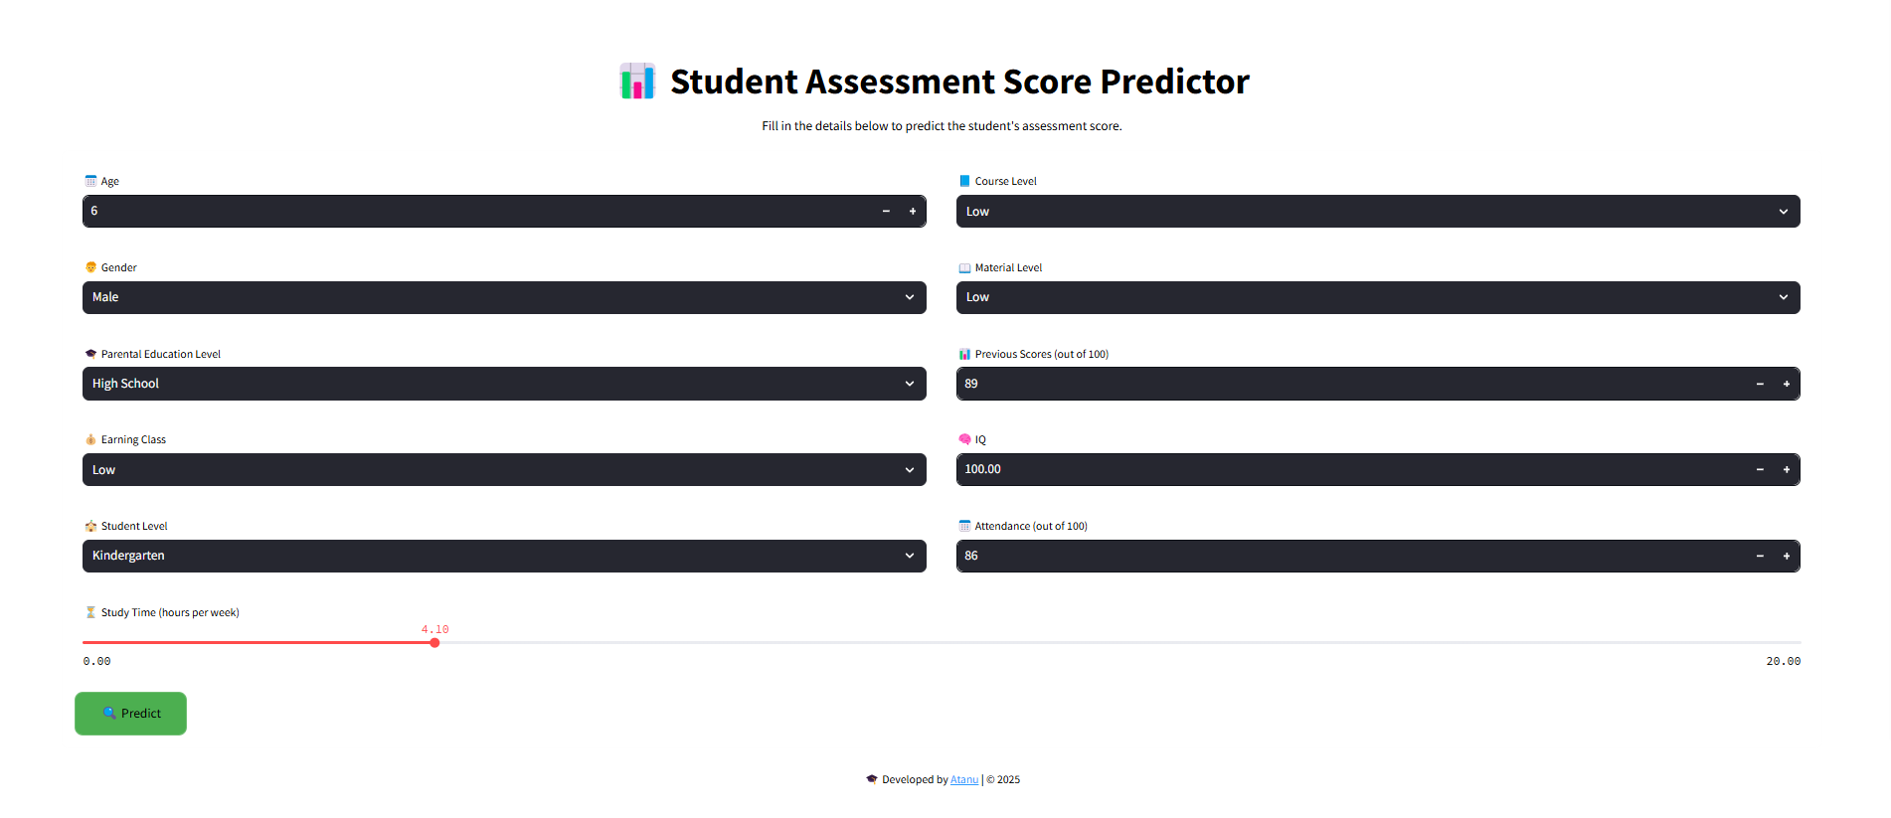
Diagram of architecture
Page : 7

Slide 11
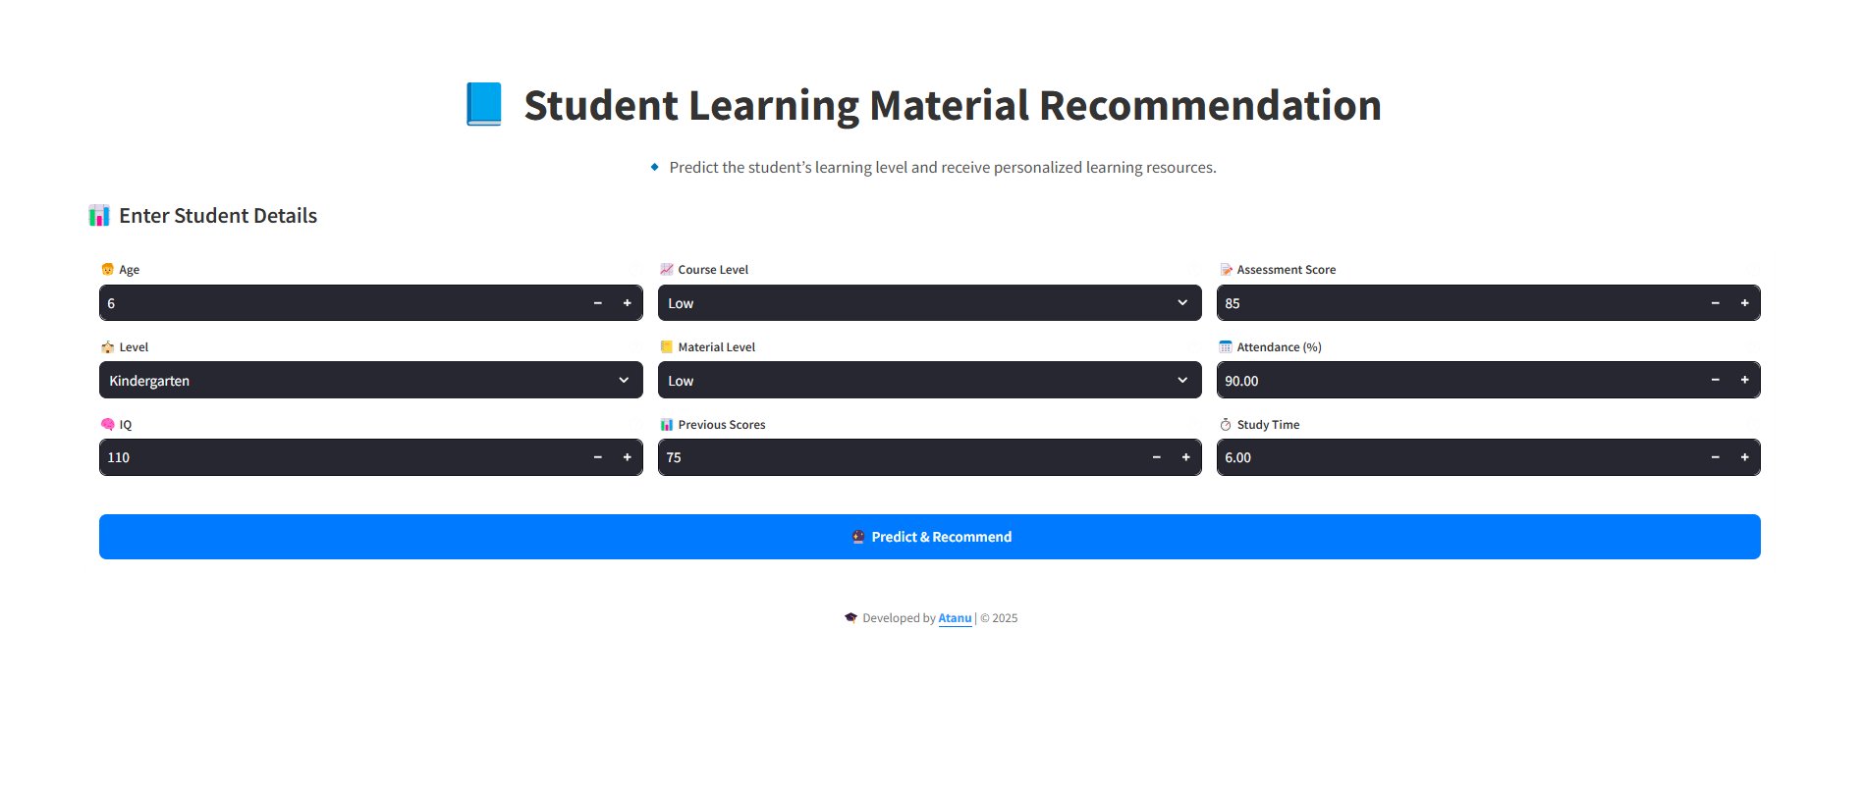

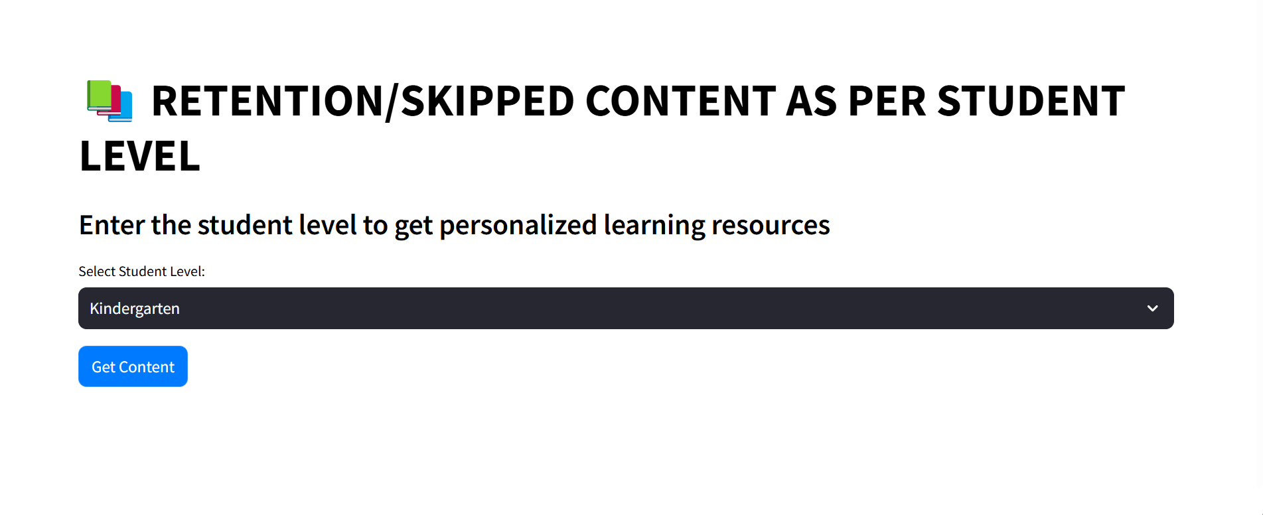
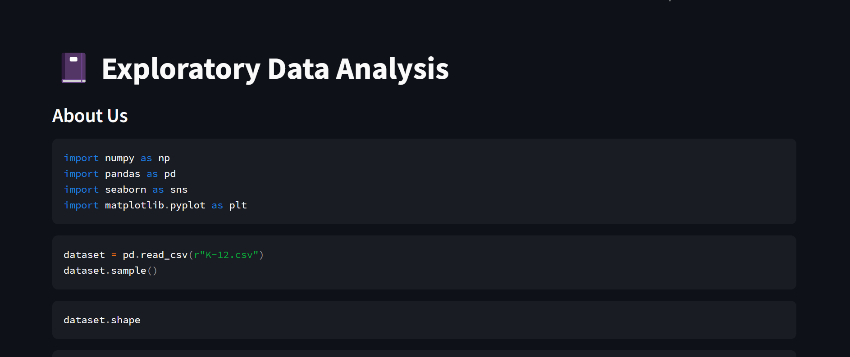
Diagram of the architecture

Slide 12
Model evaluation and result
Student Promotion Prediction
Model: RandomForestClassifier
Metrics: Accuracy Score, Confusion Matrix
Results: 99.99% accuracy score, ensuring high-quality recommendations.
Content Recommendation
Model: Softmax Regression
Metrics: Accuracy Score, Confusion Matrix
Results: 100% accurate in Content Recommendation.
Assesment Score Prediction
Model: RandomForestRegressor
Metrics: Mean squared error, r2score
Results: MSE : 0.0008, r2score : 100%
Content Retention/Skipping
Model: xgbClassifier
Metrics: Accuracy Score, Confusion Matrix
Results: 100% Accuracy score
Page : 8

Slide 13
Challenges & Limitations
Data Quality & Availability
Inconsistent or insufficient data can affect recommendation accuracy. Requires large, high-quality datasets for effective learning.
Computational Requirements
High processing power needed for AI models, especially NLP-based components. Real-time response optimization for smooth user experience.
Integration with External Platforms
Difficulty in integrating with job portals, course providers, and learning platforms. API limitations and changing platform policies.
PDF Query accuracy :
Ensuring generated answer are meaningful and not overly simple or complex.
May require human validation for high-stakes assessments.
Page : 9

Slide 14
conclusion
The AI-Powered Personal Tutor effectively enhances learning through personalized recommendations, PDF Query, Student Promotion and Assesment Score Prediction,. Despite challenges like data quality, model bias, and computational requirements, the system demonstrates high accuracy, engagement, and scalability. Future improvements will focus on refining AI models, ensuring fairness, and enhancing user experience to create a truly adaptive learning platform.
Page : 10

Slide 15
reference
CampusX : Educational content, machine learning resources, and practical implementation guidance. Retrieved from https://www.campusx.in
Deepseek AI : AI-powered solutions and model assistance. Retrieved from https://www.deepseek.com
OpenAI. (2025). ChatGPT: A conversational AI. Retrieved from https://www.openai.com/chatgpt
Page : 11

Slide 16
Thank you

